Slide 1
Building a Production-Ready ML Pipeline for Loan Default Prediction
Created by: Justin Ng
Date: Nov 25

Slide 2
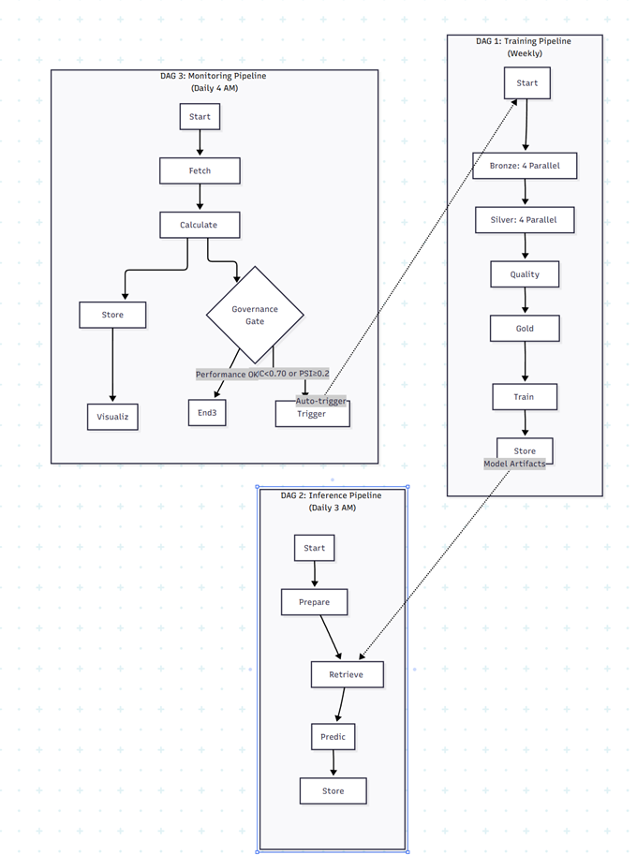
High-Level Architecture: The 3 DAG System
Training DAG
Inference DAG
Monitoring DAG
Builds and validates the best model from raw data. Runs weekly or on-demand.
Loads the production model to generate batch predictions. Runs daily.
Tracks performance and data drift, triggering retraining via the Governance Gate.

Slide 3
DAG 1: The Training Pipeline

Slide 4
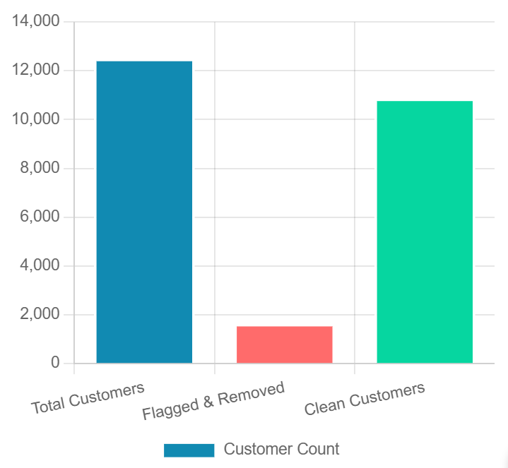
Part 1: Bronze & Silver Data Cleaning
Key Silver Cleaning Logic (PySpark)
Attributes Table:
Validates SSN (e.g., rlike(r'^\d{3}-\d{2}-\d{4}$')) and cleans Age (e.g., regexp_replace(r'[^0-9]', ''))
Financials Table:
Cleans 9 float and 6 integer columns using mass regex and removes placeholders like '_', 'NM', and '!@9#%8'
Clickstream Table:
Cleans all 20 fe features, correctly handling negative numbers with regexp_replace(r'[^0-9-]', '')
Data Quality Check Gate
The Quality Check Gate identifies and removes customers with invalid data (e.g., bad SSNs, negative income) from all 4 tables before the Gold layer.

Slide 5
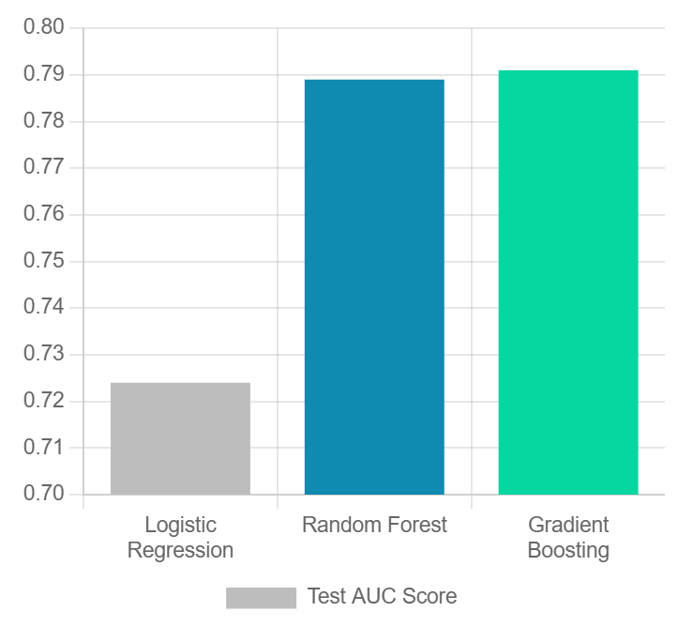
Part 2: Gold Feature Engineering
Key Temporal Logic (PySpark)
Point-in-Time Snapshots: Prevents data leakage by joining prediction_date against attributes and financials tables to get the latest snapshot of customer data on or before that date.
Windowed Aggregates: Clickstream features are aggregated only from data before loan_start_date. Loan history is aggregated only from installments before Month 3.
Model Competition: Test AUC
Key Engineered Features
Credit_History_Months: Parses "7 Years 3 Months"
DTI (Debt-to-Income): Total_EMI_per_month / Monthly_Inhand_Salary
Savings_Ratio: Amount_invested_monthly / Monthly_Inhand_Salary
hist_Loan_Payment_Ratio: hist_total_paid / hist_total_due
Three models compete. The best model (highest Test AUC) is automatically selected and versioned with its metadata and encoders for production use.

Slide 6
DAG 2: The Inference Pipeline

Slide 7
Part 1: Daily Inference Pipeline
Retrieve Model
Prepare Data
Generate Predictions
Store Results
Load best_model.pkl and label_encoders.pkl from Model Store.
Apply the same Gold Layer feature engineering to new data.
Score the new features and generate prediction_proba.
Save predictions to a
Gold datamart table for
the Monitoring DAG.
The daily inference pipeline is simple and fast. It loads the versioned production model and applies it to new data to generate daily predictions.

Slide 8
DAG 3: Monitoring & Governance

Slide 9
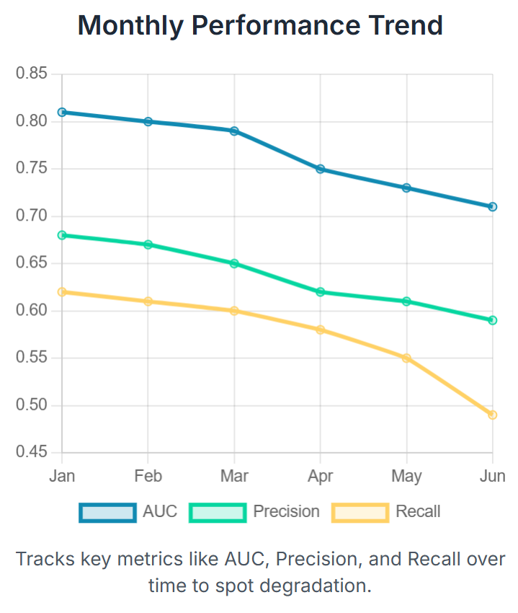
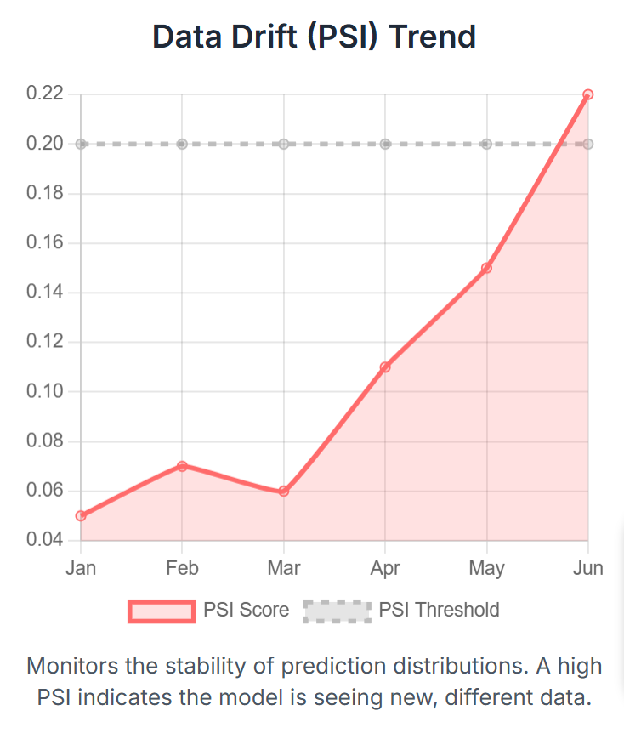
Part 1: Performance & Drift Tracking
The Monitoring DAG runs daily to calculate performance against actuals and detect data drift by tracking the Population Stability Index (PSI).

Slide 10
Part 2: The Automated Governance Gate
The Airflow BranchPythonOperator checks a robust set of 4 rules. If any rule is breached, it automatically triggers a new run of the entire Training Pipeline, creating a self-healing system.
Governance Triggers
AUC < 0.70
Model performance is poor.
Precision < 0.60
Too many false positives.
Recall < 0.50
Missing too many real defaults.
PSI >= 0.2
Significant data drift detected.
Automated Action
Governance Gate
(Check 4 Rules)
If Any Fails
If All Pass
End
Retrigger Training

Slide 11
Key Insights & Lessons Learnt
Business Impact
Faster Response
Automated governance provides a rapid response to changing data patterns.
Improved Reliability
Stakeholder trust improved due to automated governance and drift detection.
Enhanced Compliance
Creates a transparent, auditable trail for regulatory requirements.
Technical Lessons
Modularity is Key
Modular, testable code (like the separate Python scripts) is critical for maintainability.
Clear Thresholds
Defining explicit metrics (AUC < 0.7, PSI >= 0.2) simplifies governance.
Data Lineage
Robust storage (Bronze/Silver/Gold) is essential for debugging and compliance.
Process Lessons
Collaboration:
Close partnership between Data Science and Engineering accelerates delivery.
Automation Frees Capacity
Automation reduces manual errors and frees up the team to focus on new problems.
Monitoring is Non-Negotiable
Continuous monitoring is the key to long-term model success.

